Slide 1
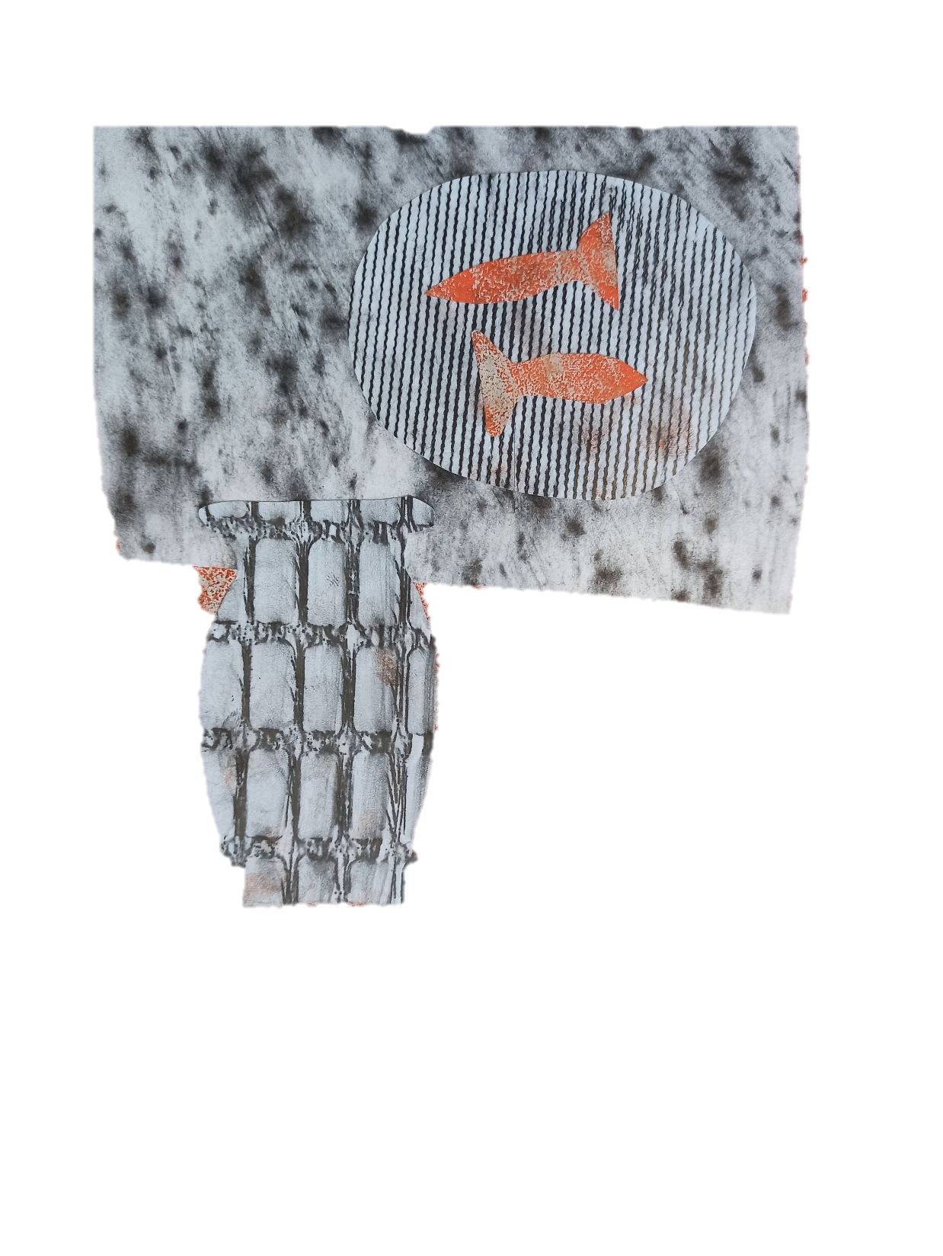
Distant Spaces
Class 4: Collage
Evening Classes created by Lilian Ptáček

Slide 2
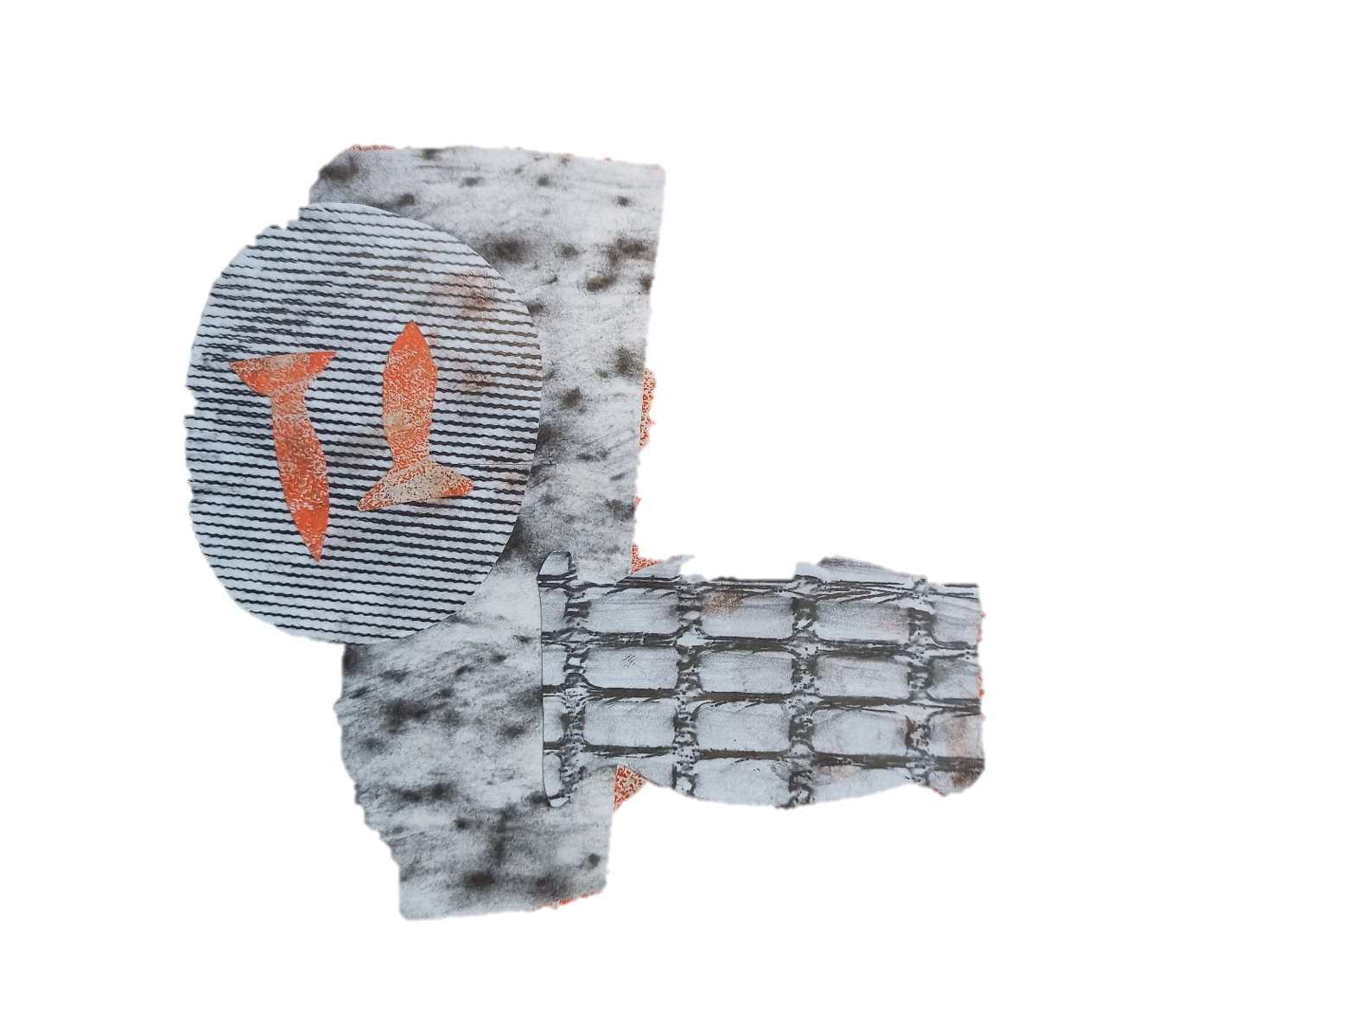
Class 4
In this class we will:
Discuss Sara Barker’s work and approach to making.
Print our collagraph plates
Create a collage using the different textures and images generated over these evening classes.
Discuss work made during the course.

Slide 3
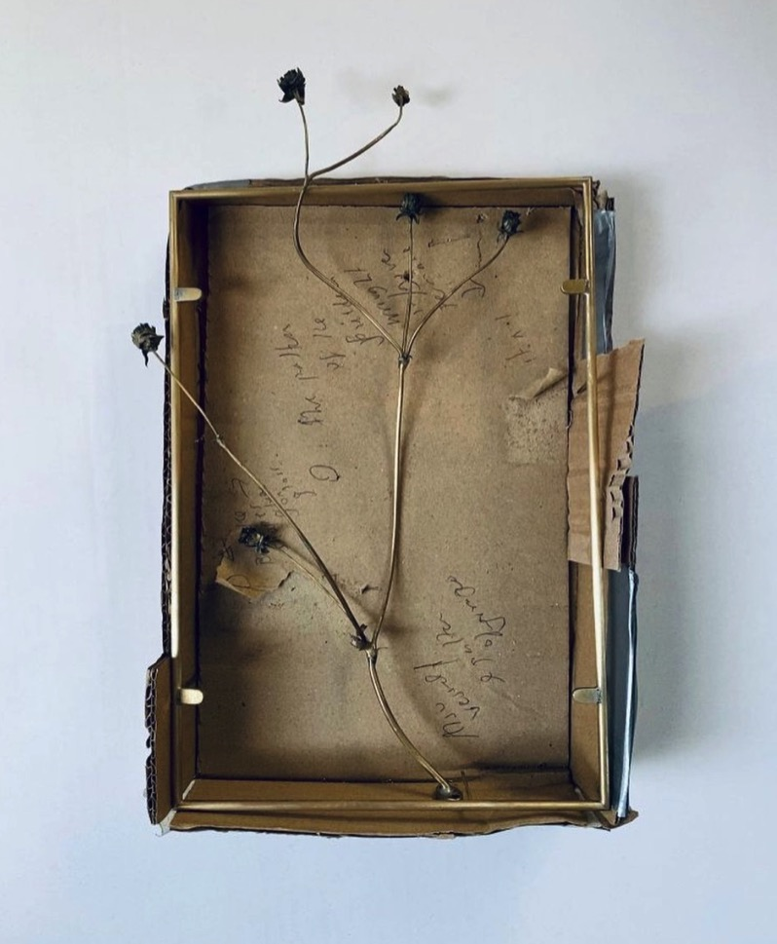
Sara Barker, 2020

Slide 4
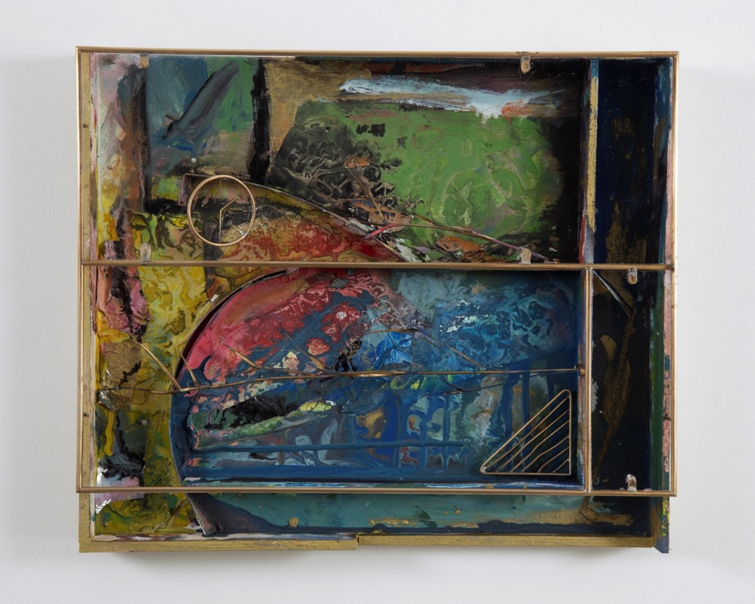
Sara Barker, Reason, 2020

Slide 5
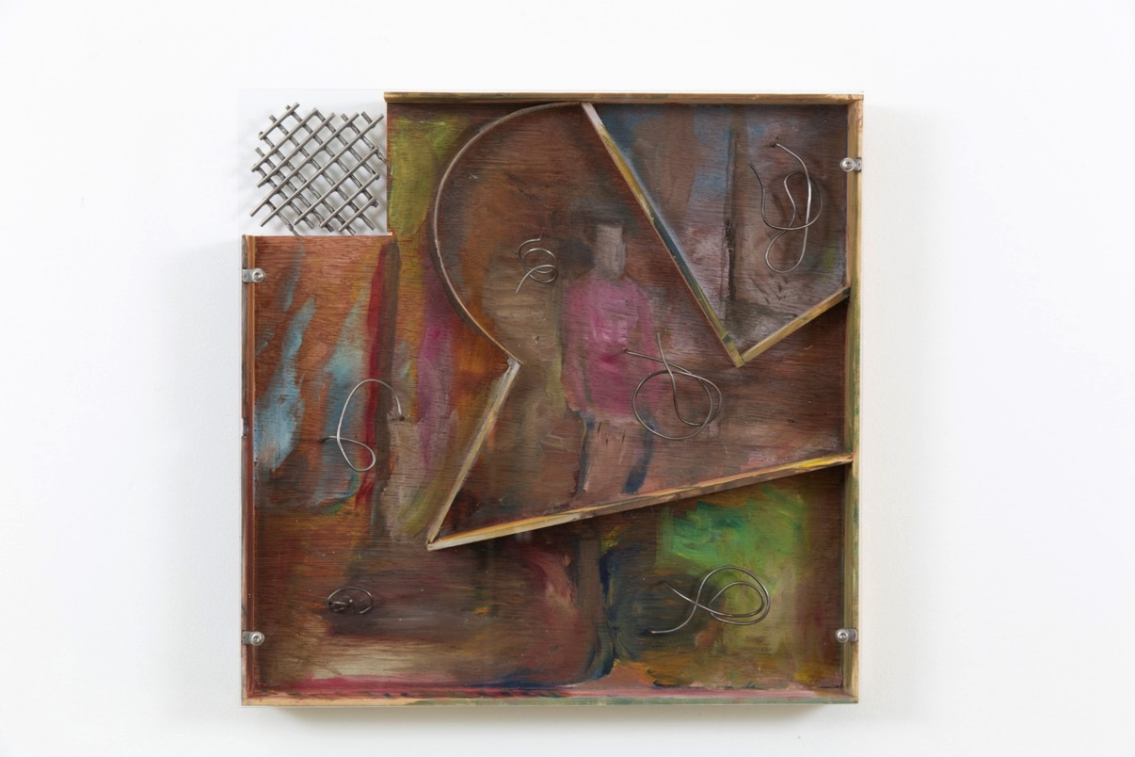
Sara Barker, 2020

Slide 6
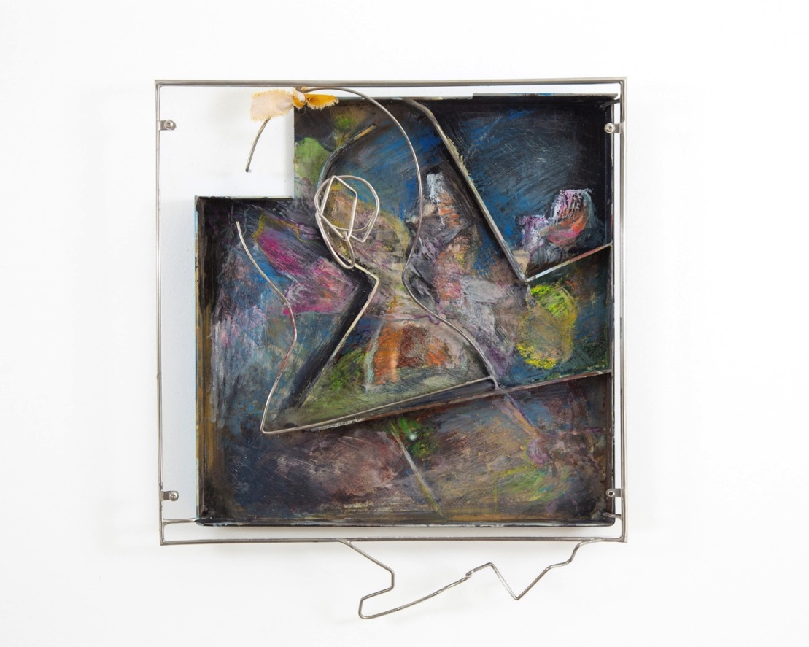
Sara Barker, 2020

Slide 7
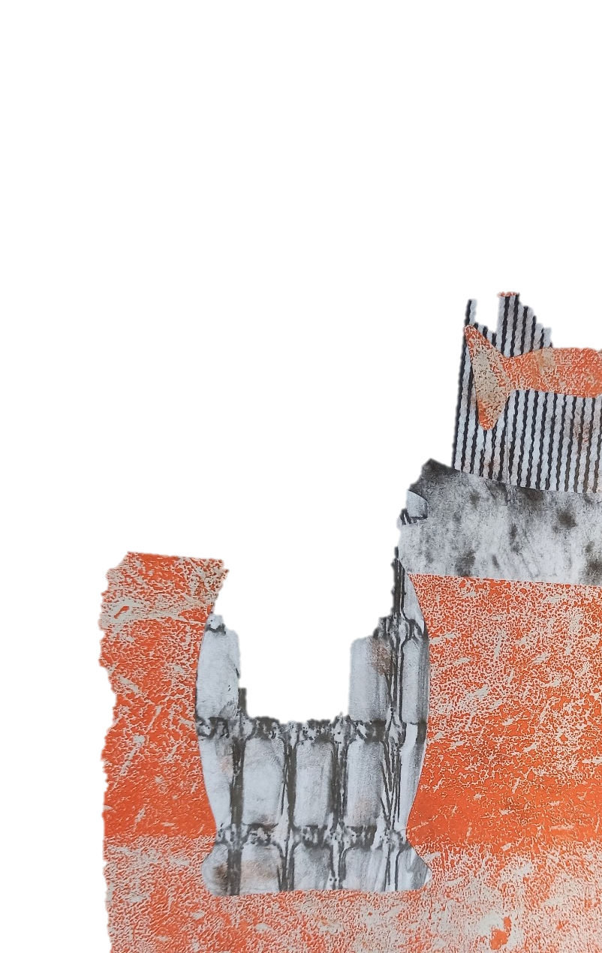
Collagraph Printing
Roll out some ink onto a surface or tray.
Roll the ink over the surface of the collagraph plate.
Press the plate onto the paper and apply pressure on the back with a clean roller, wooden spoon or your hand, and transfer the ink onto the paper.
If you want to change the colour you are printing with, wash your plate and let it dry.
30 mins

Slide 8
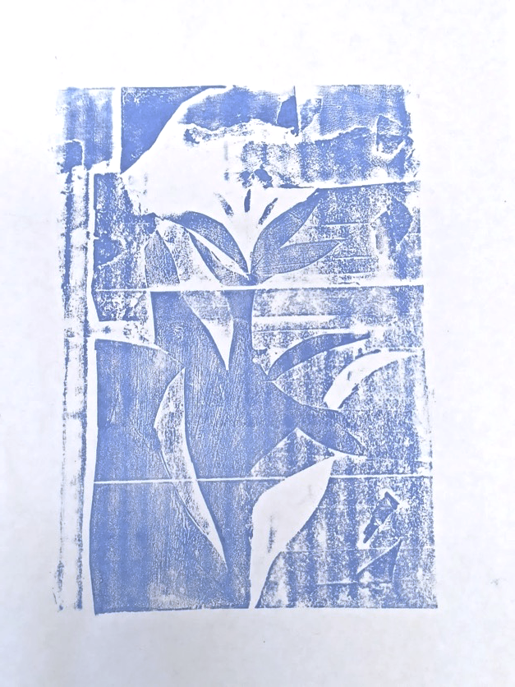
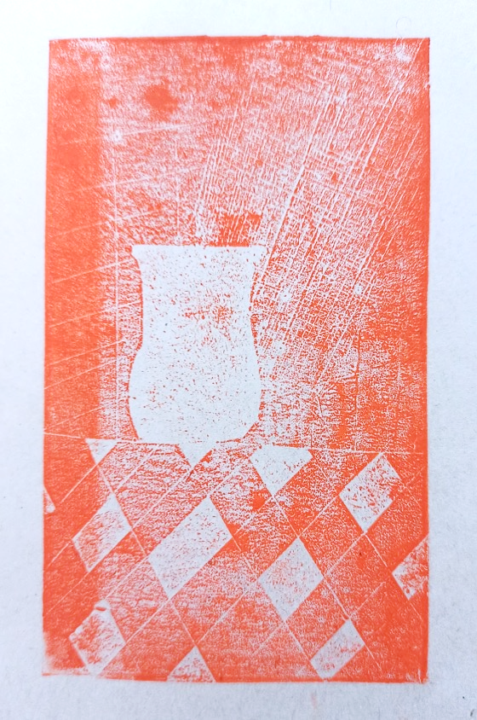
Collagraph Examples

Slide 9
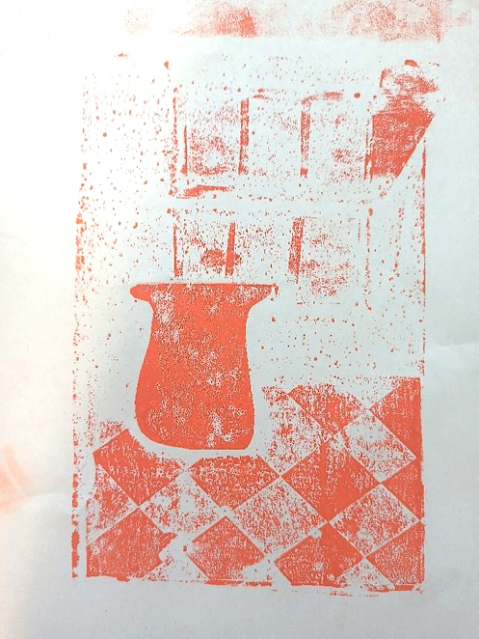
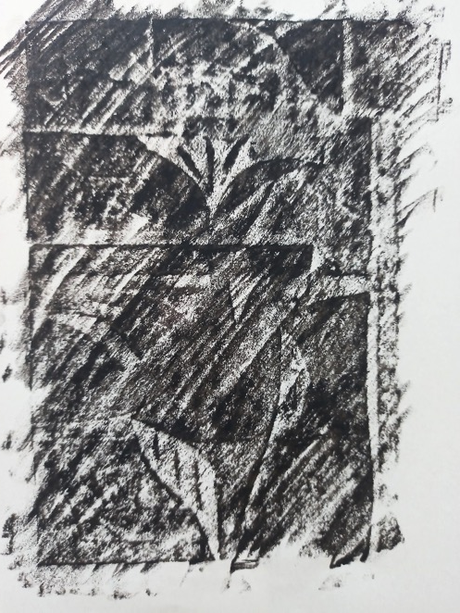
Collagraph Examples

Slide 10
Collage activty
Look at the prints you have created over the course and select some that you would like to collage with.
Write some notes about this material:
Why are these materials significant to you?
What connections or visual associations can you make between these materials?
Which material is contrasting/clashing, which is complimentary?
Create a collage based on your location. You might decide on the composition of your collage before you start. Or you might use the process of collage to work this out. You can create your collage on any object or material you like.
35 mins

Slide 11
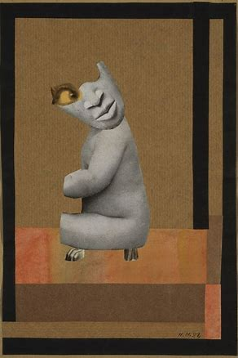
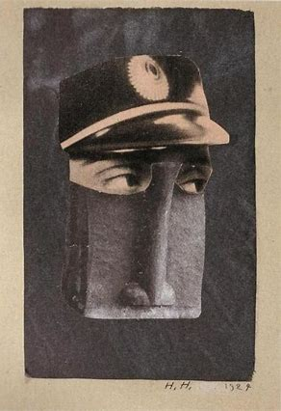
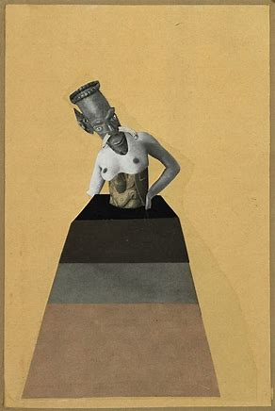
Collage Examples
Hannah Hoch, From the series and Ethnographic Museum, 1930

Slide 12
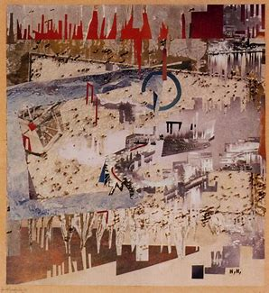
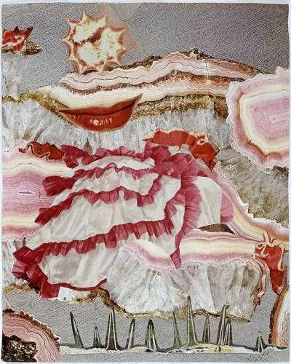
Collage Examples
Hannah Hoch, Industrial Landscape & Around a Red Mouth, 1967

Slide 13
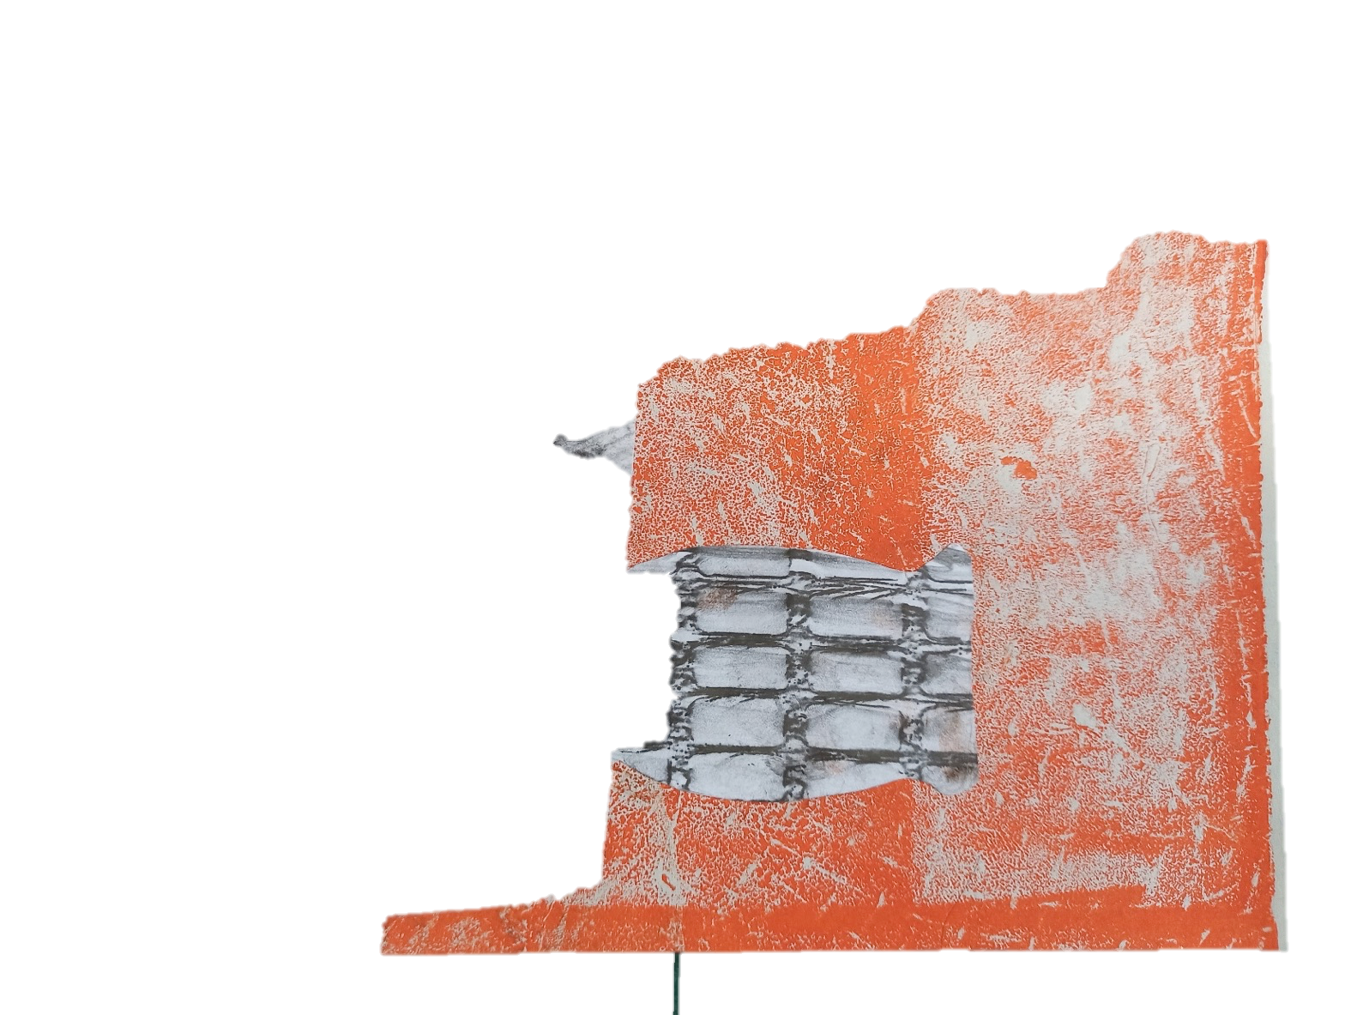
Sharing
Please email me an image of a piece you have made during this course and I will share them on my screen. Lilianptacek@gmail.com
15 mins

Slide 14
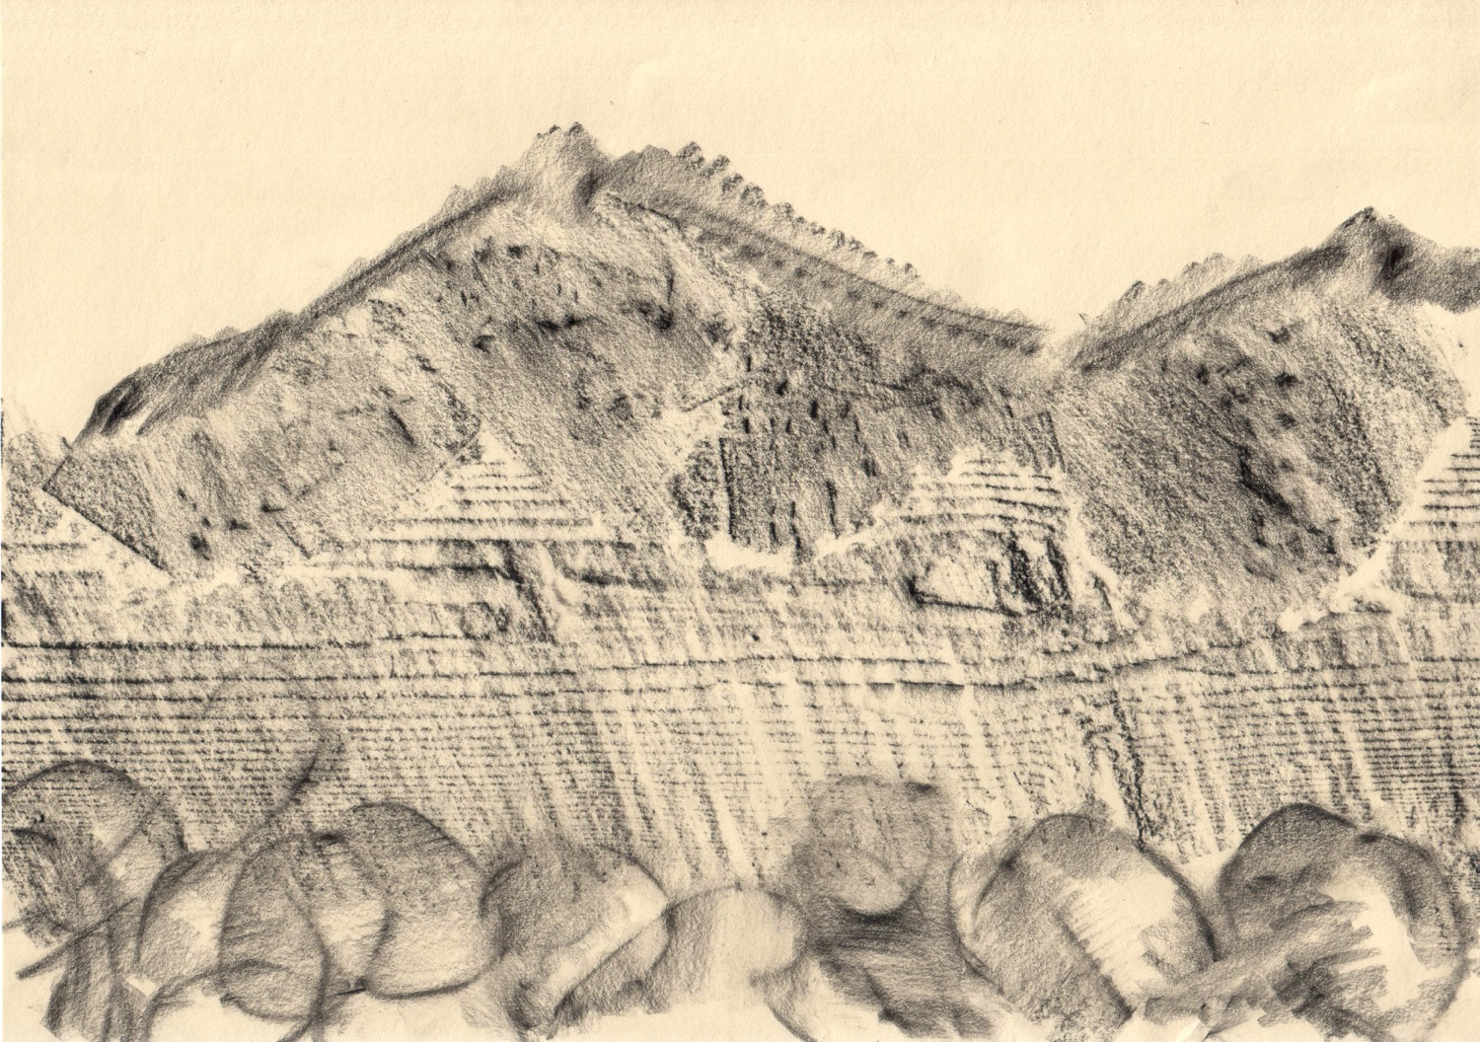

Slide 15
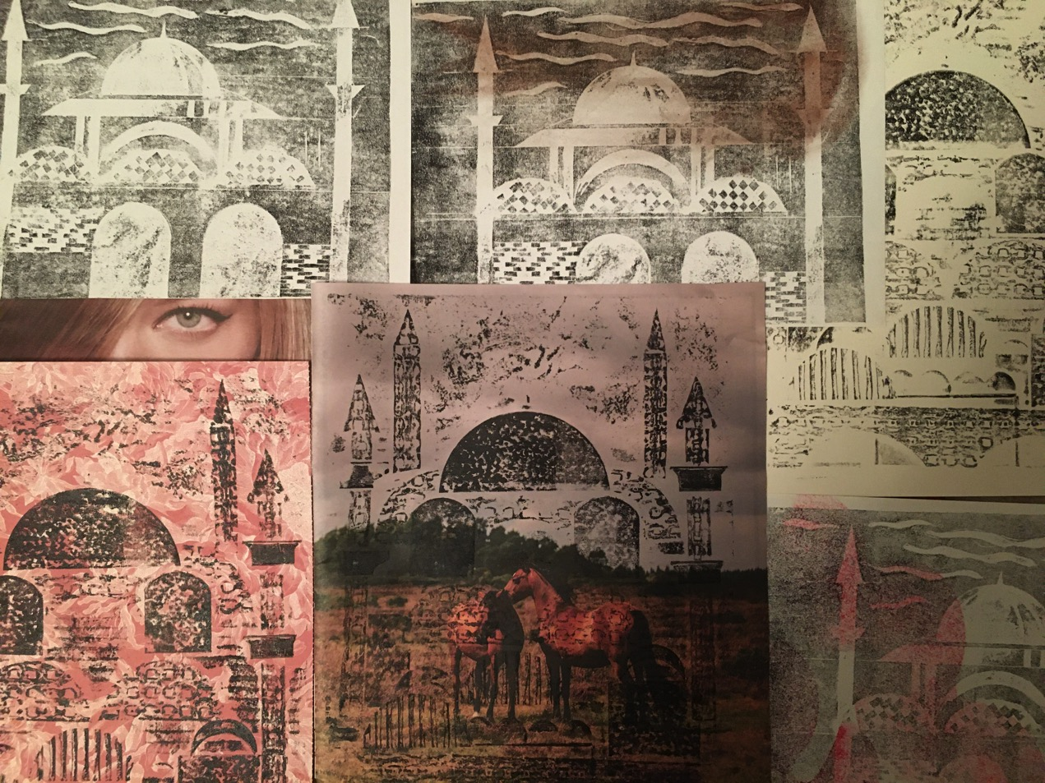

Slide 16
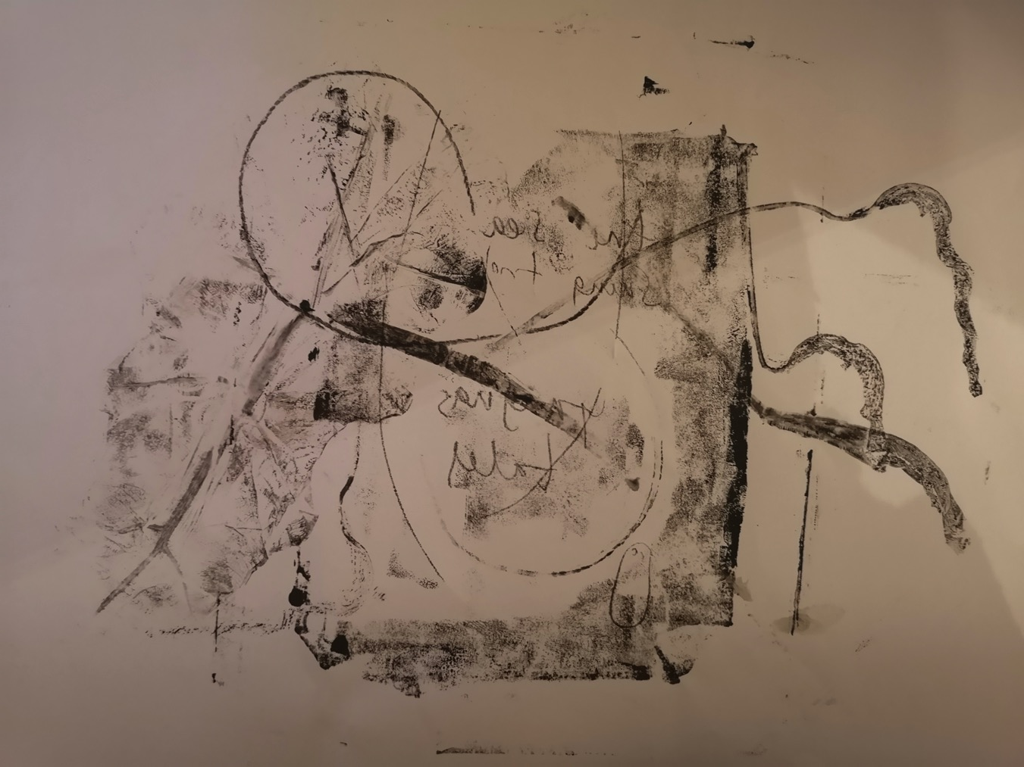

Slide 17
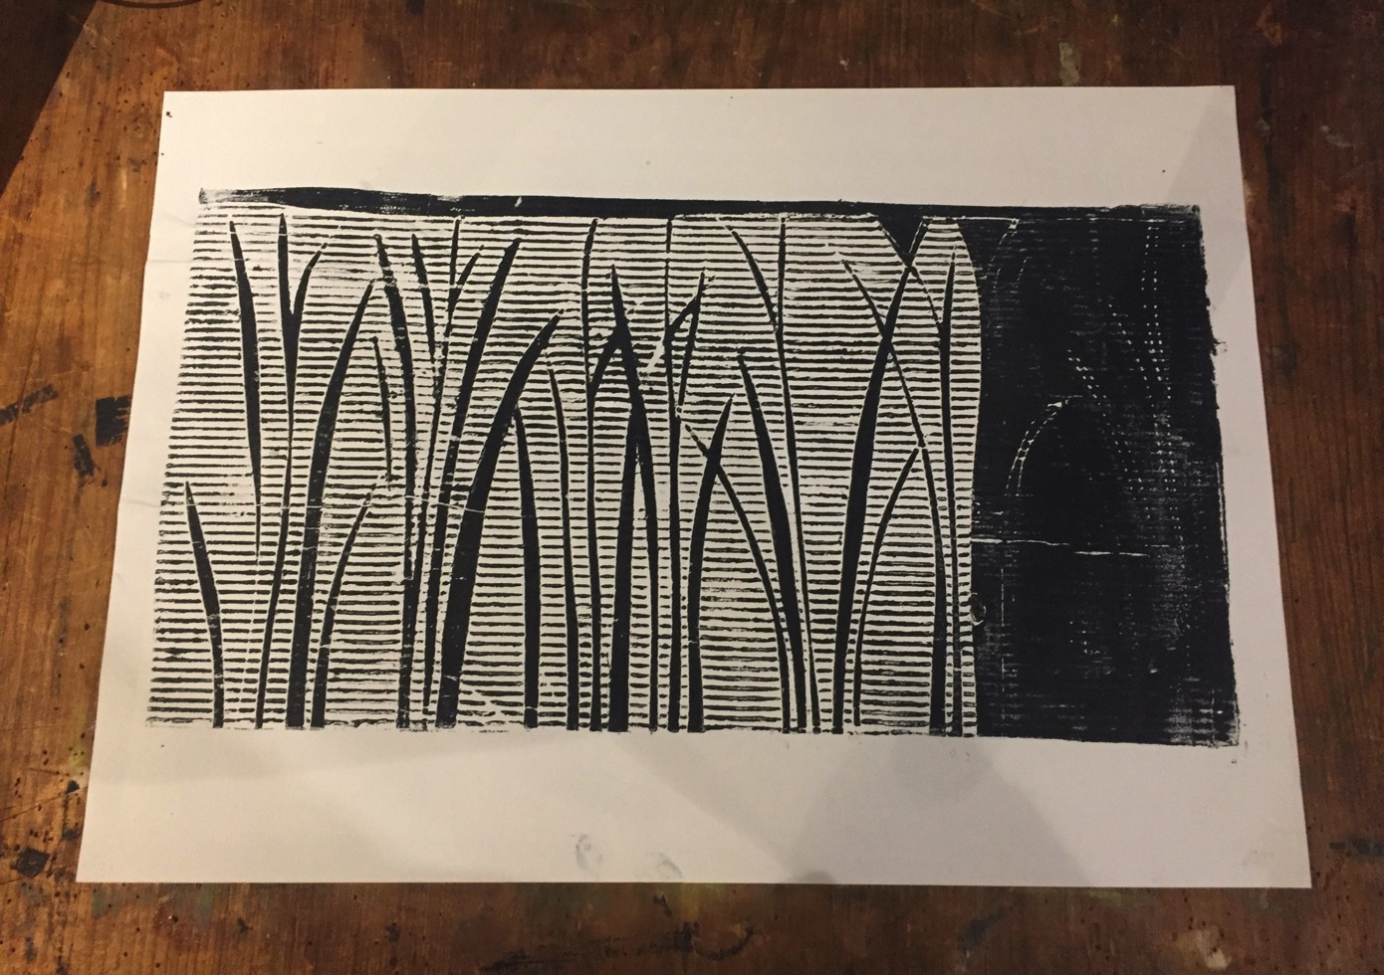

Slide 18
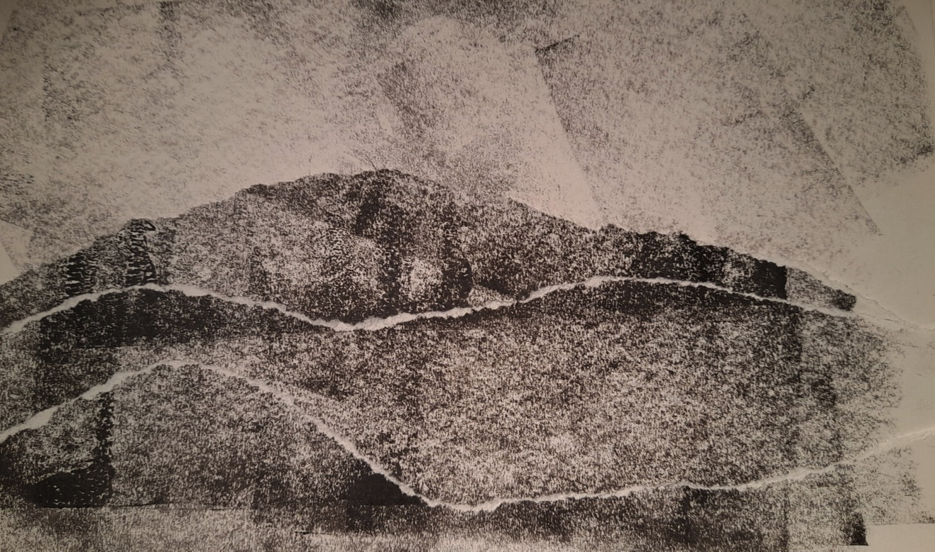

Slide 19
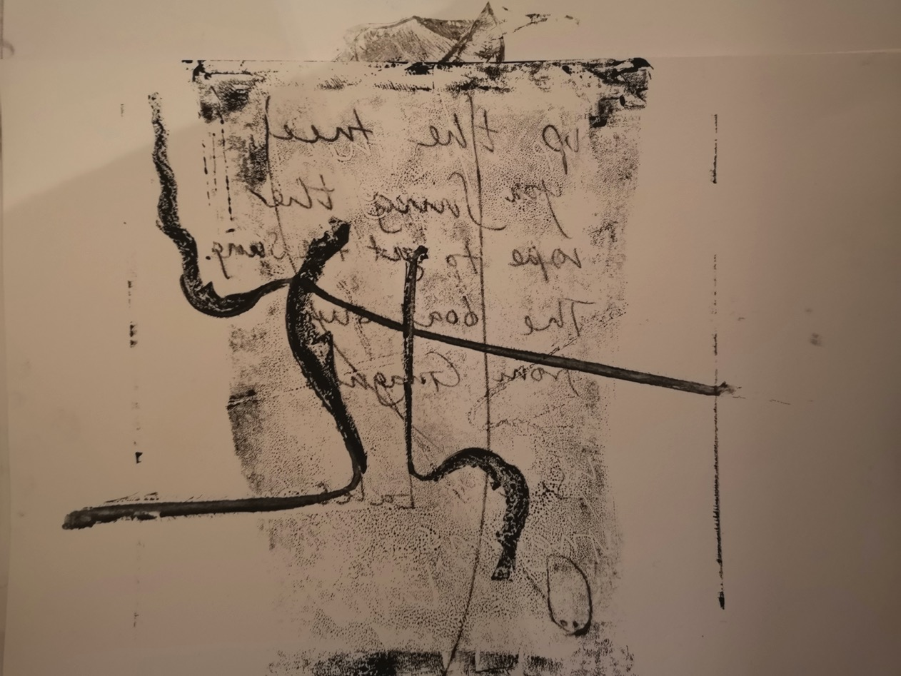

Slide 20
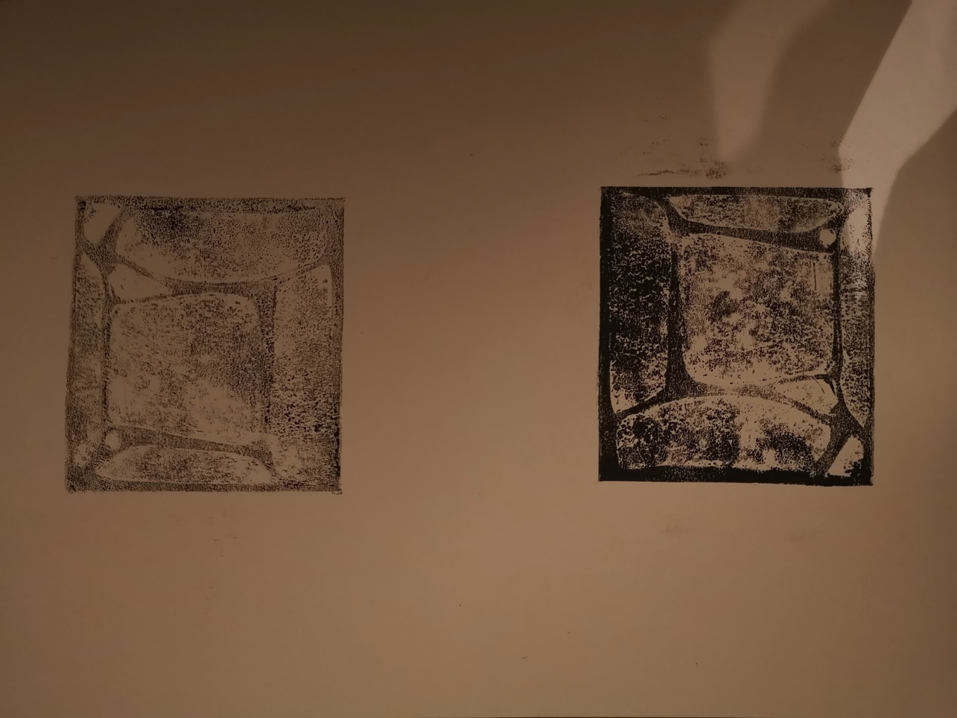

Slide 21
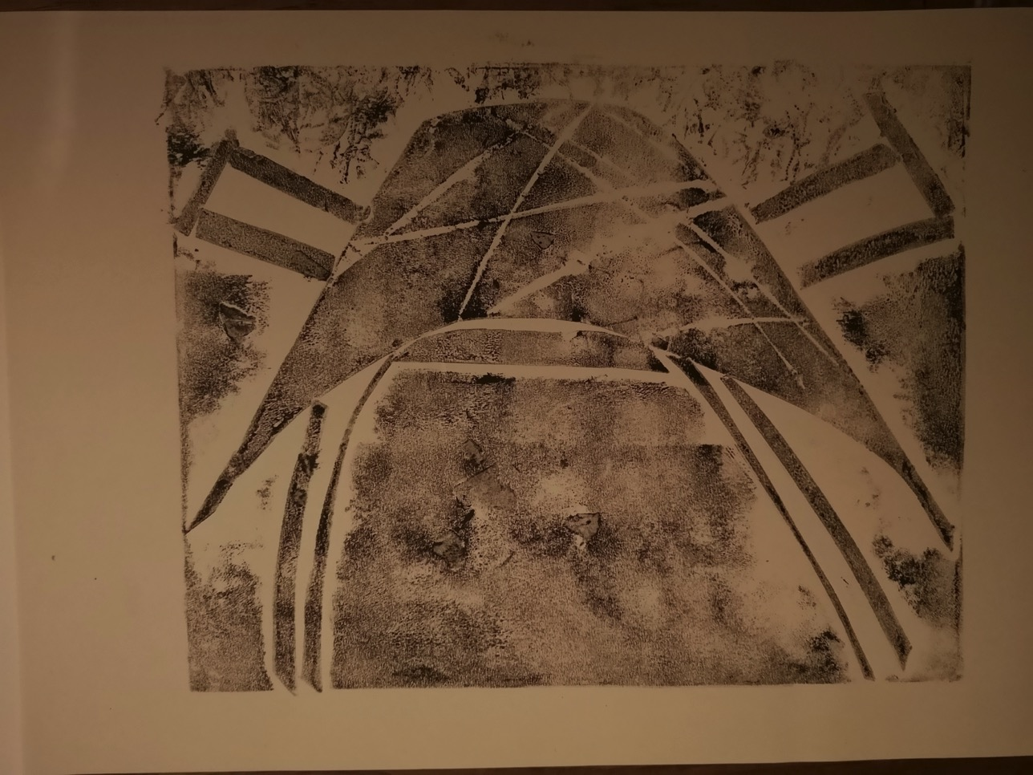

Slide 22
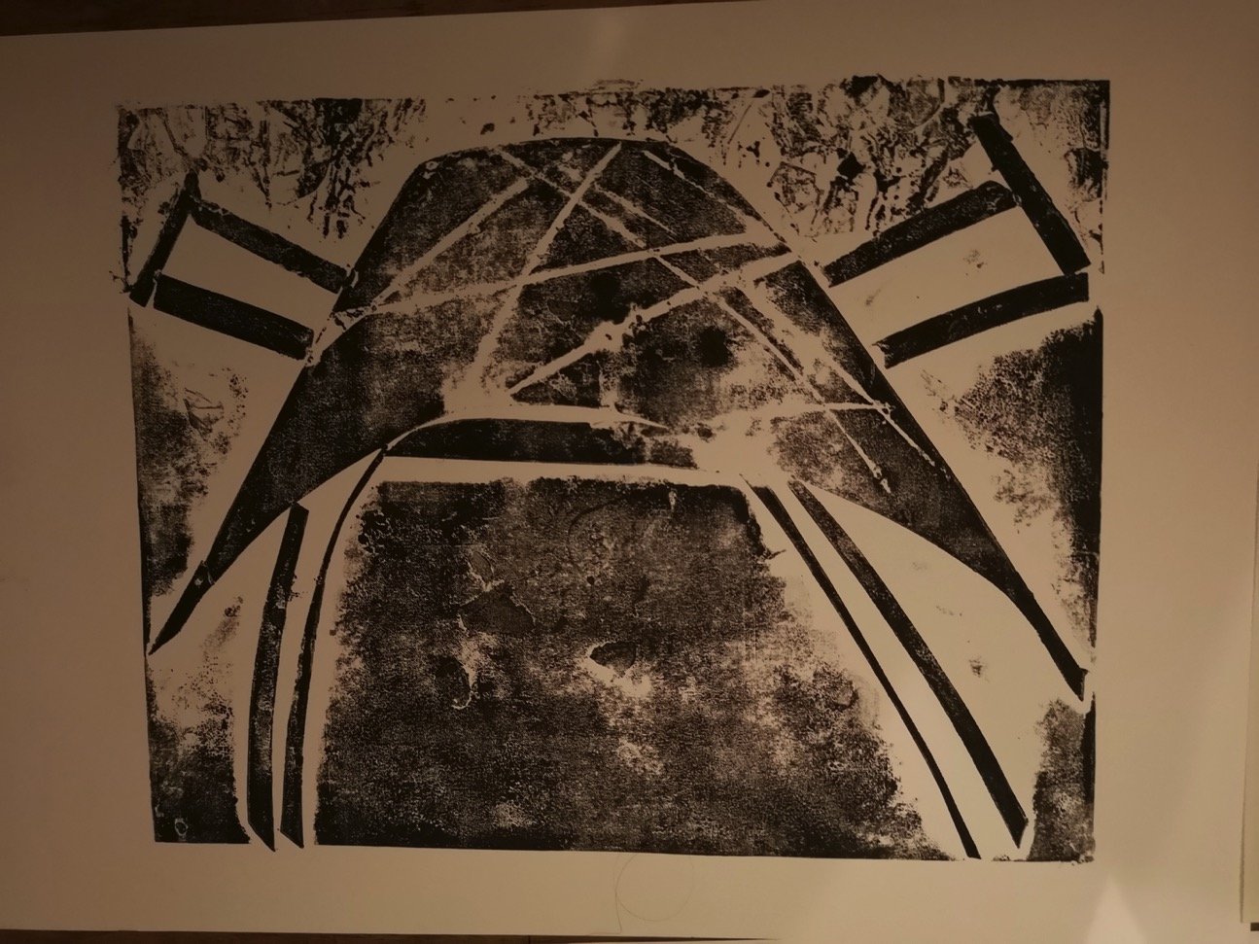

Slide 24
